Slide 1
EECE 229 - Introduction to Digital Systems Introduction and Number Representations
Dr. Elmannai
Manhattan College
Fall 2020

Slide 2
Outline
Introduction
Number Representation: Binary, Octal, and Hexadecimal numbers
Bases
Conversions
Addition and subtraction
Number complements
Unsigned numbers
Signed numbers
Other binary codes
Binary logic

Slide 3
Introduction To Digital Systems

Slide 4
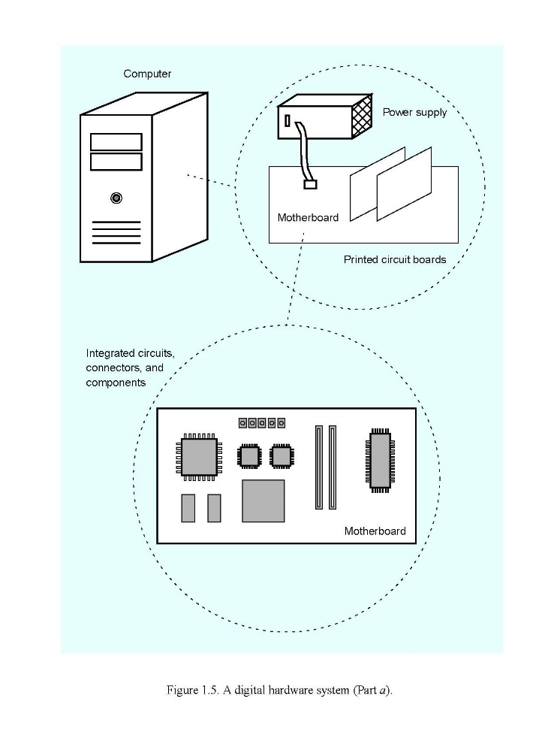
Structure of a computer
Notes:
The computer case houses a number of printed circuit boards (PCBs), a power supply, and storage units, like a hard disk and DVD drives. Each unit is plugged into a main PCB, called motherboard. The motherboard holds several integrated circuit chips, and provides slots for connecting other PCBs, such as audio, video, and network boards.

Slide 5
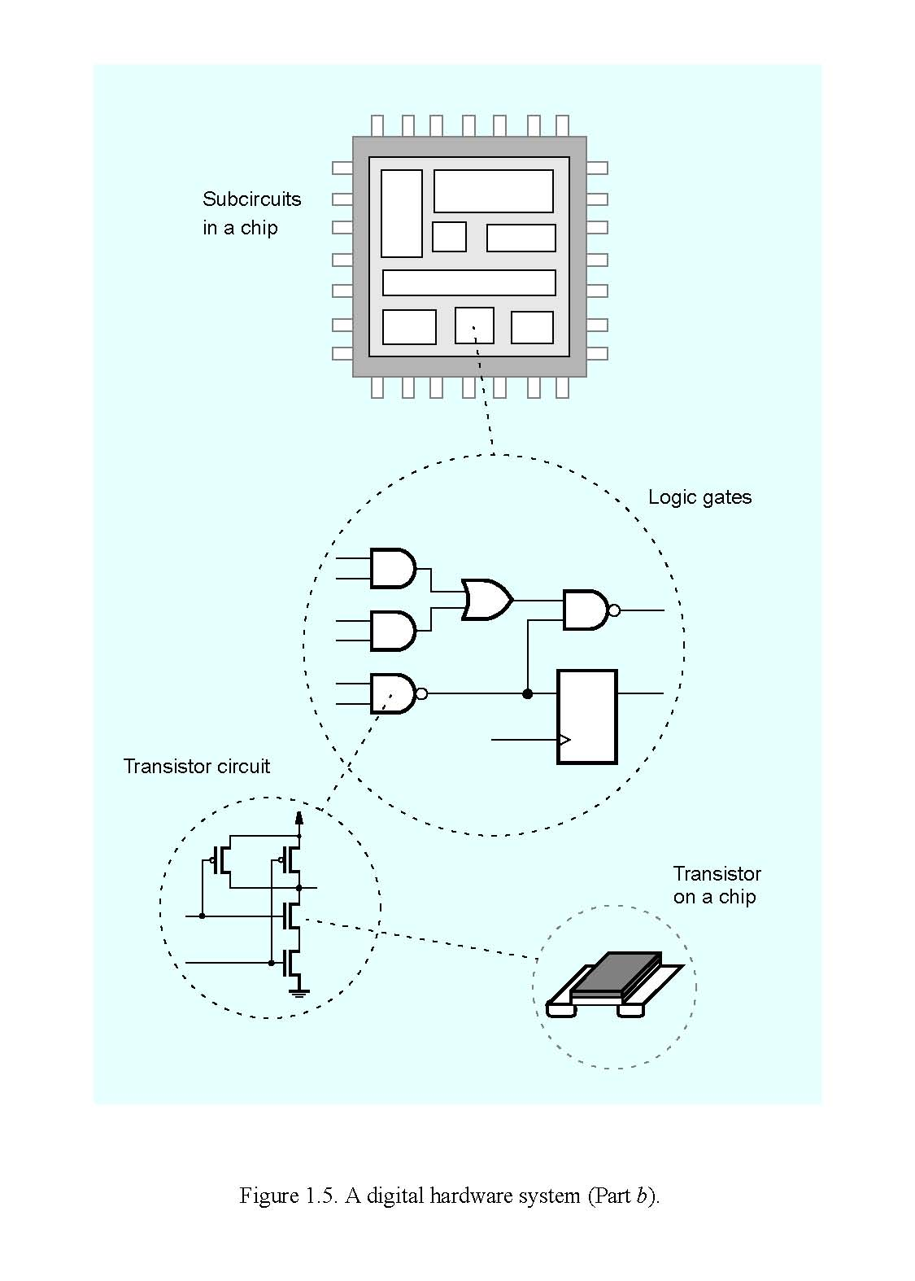
Design of logic circuits
Notes:
IC Chips are housed on PCB's
It illustrates the structure of an integrated circuit chip. The chip comprises a number of sub-circuits, which are interconnected to build the complete circuit. Examples of sub-circuits are those that perform arithmetic operations, store data or control the flow of data. Each of the sub-circuits is a logic circuit. A logic circuit comprises a network of connected logic gates.
We primarily are concerned about the design of logic circuits. How to design circuits that perform important functions, such as adding, subtracting, or multiplying numbers, counting, storing data, and controlling the processing of information.
An integrated circuit (IC), sometimes called a chip or microchip, is a semiconductor wafer on which thousands or millions of tiny resistors, capacitors, and transistors are fabricated. An IC can function as an amplifier, oscillator, timer, counter, computer memory, or microprocessor.

Slide 6
Logic Circuit Design
In this course, we use a modern design approach, based on Verilog and CAD tools.
Widely used in industry
Implement designs in FPGA chips
Major vendors of CAD tools: Altera, Cadence, Mentor graphics, Synopsys, Xilinx.
Quartus II: support all phases of the design cycle for logic circuits, powerful, easy to use.

Slide 7
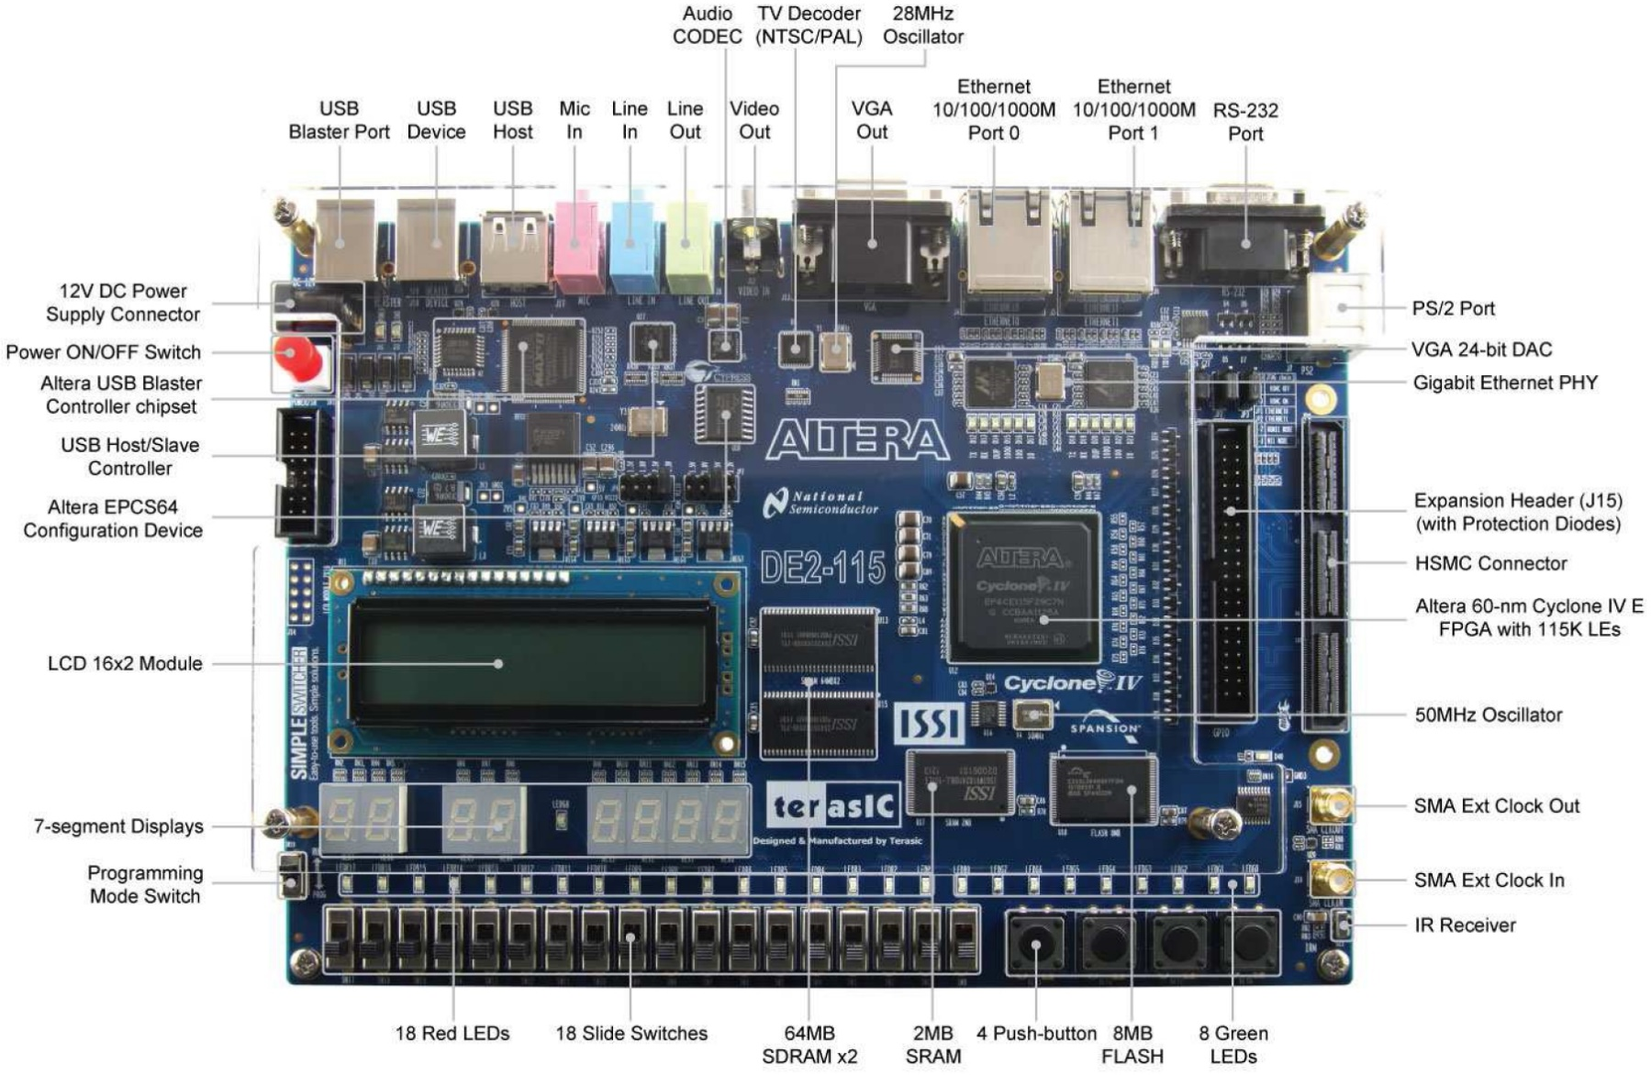
FPGA Board
Notes:
Once a logic circuit has been designed using CAD tools, the circuit can be programmed into an FPGA o the board.
It is an excellent vehicle, a collection of simple inputs and output devices!
A field-programmable gate array (FPGA) is an integrated circuit designed to be configured by a customer or a designer after manufacturing – hence "field-programmable
FPGAs contain an array of programmable logic blocks,

Slide 8
Digital Systems
Digital Systems
Inputs and outputs: finite number of discrete values
Modeled as taking only one of two discrete values at any time
0/1, low/high, false/true
Analog Systems
Inputs and outputs: from a continuous (infinite) set

Slide 9
Analog versus Digital
Analog Voltage meter
Digital Voltage meter
103.5
About 100

Slide 10
Number representations

Slide 11
Digital Logic
Discrete elements of information are represented in a digital system by physical quantities called signals.
Signals in electronic digital systems use just two discrete values, i.e. binary
Can take on Two States represented by voltage levels (high and low).
We can think of these as representing any 2-valued system:
“1” or “0” (“binary digits” or bits)
“True” or “False”
“on” or “off”

Slide 12
Grouping bits
We can group bits to represent larger numbers of things:
Common terms of reference:
bit: 1 binary digit
byte: 8 bits
word: often 16 bits (may vary)
0
1
Black
White
00
01
10
11
Black
White
Blue
Red
000
001
010
011
100
101
110
111
Black
White
Blue
Red
Yellow
Orange
Pink
Green
With n bits, we
can represent
2^{n} values or
give a unique
identifier to 2^{n}
things!
Notes:
On large mainframes, a word can be as long as 64 bits (8 bytes).Some computers and programming languages distinguish between shortwords and longwords. A shortword is usually 2 bytes long, while a longword is 4 bytes.

Slide 13
Counting in Binary
Decimal
0
1
2
3
4
5
6
7
8
9
10
11
12
13
14
15
Binary
0
1
10
11
100
101
110
111
1000
1001
1010
1011
1100
1101
1110
1111

Slide 14
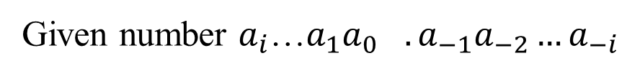
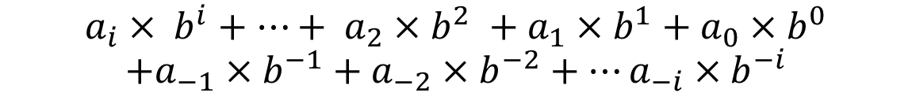
Conversions ANY Base to Base 10 (Decimal)
Given number $a_{i}$…${a_{1}a_{0}}_{}.a_{−1}a_{−2}…a_{−i}$
Write in the form:
$$a_{i}× b^{i}+…+ a_{2}×b^{2} +a_{1}×b^{1}+a_{0}×b^{0}$$
$$+a_{−1}×b^{−1}+a_{−2}×b^{−2}+…a_{−i}×b^{−i}$$
Where: “a” represents the coefficients
“b” is the base
Complete the sum, the answer will be in base 10.

Slide 15
Conversions Base 10 to ANY Base
The positional notation gives an easy way to convert from a binary number to the decimal equivalent.
(1101)₂ =
1x2³ + 1x2² + 0x2¹ + 1x2⁰
= 8 + 4 + 0 + 1
= (13)₁₀

Slide 16
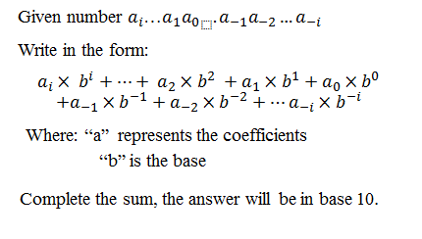
Converting from binary to decimal
The positional notation gives an easy way to convert from a binary number to the decimal equivalent.
1101.101₂ =
1x2³ + 1x2² + 0x2¹ + 1x2⁰ + 1x2⁻¹ + 0x2⁻² + 1x2⁻³
= 8 + 4 + 0 + 1 + 0.5 + 0 + 0.125 = 13.625₁₀

Slide 17
Example 1
1 x 2⁰ = 1 x 1 = 1
0 x 2¹ = 0 x 2 = 0
1 x 2² = 1 x 4 = 4
1 x 2³ = 1 x 8 = 8
0 x 2⁴ = 0 x 16 = 0
1 x 2⁵ = 1 x 32 = 32
• (101101)2 = (?)10
1 + 0 + 4 + 8 + 0 + 32 =
(45)10
Notes:
45

Slide 18
Base 8 (Octal)
Octal
Decimal Equivalent
0 ………………………... 0
1 ………………………... 1
2 ………………………... 2
3 ………………………... 3
4 ………………………... 4
Example:
147₈ = 1 x 8² + 4 x 8¹ + 7 x 8⁰
= 64 + 32 + 7
= 103₁₀
5 ………………………... 5
6 ………………………... 6
7 ………………………... 7
10 ………………………... 8
11 ………………………... 9
12 ………………………..10
13 ………………………..11
14 ………………………..12
15 ………………………..13
16 ………………………..14
17 ………………………..15
20 ………………………..16

Slide 19
Base 16 (Hexadecimal or “Hex”)
Hex Digit
Decimal Equivalent
0………………………... 0
1 ………………………... 1
2………………………... 2
Examples:
3 ………………………... 3
4 ………………………... 4
5 ………………………... 5
6 ………………………... 6
7 ………………………... 7
8 ………………………... 8
9 ………………………... 9
A ………………………..10
B ………………………..11
C ………………………..12
D ………………………..13
E ………………………..14
F ………………………..15
21₁₆
5F₁₆
B65F₁₆
= 2 x 16¹ + 1 x 16⁰ = 33₁₀
= 5 x 16¹ + 15 x 16⁰ = 95₁₀
= 11 x 16³ + 6 x 16² + 5 x 16¹ + 15 x 16⁰
= 45,056 + 1,536 + 80 + 15
= 46,687₁₀

Slide 20
Decimal
0
1
2
3
4
5
6
7
8
9
10
11
12
13
14
15
Binary
0000
0001
0010
0011
0100
0101
0110
0111
1000
1001
1010
1011
1100
1101
1110
1111
Octal
00
01
02
03
04
05
06
07
10
11
12
13
14
15
16
17
Hexadecimal
0
1
2
3
4
5
6
7
8
9
A
B
C
D
E
F

Slide 21
Example 2
• (A37)16 = (?)10
7 x16⁰ = 7 x 1 = 7
3 x 16¹ = 3 x 16 = 48
A x 16² = 10 x 256 = 2560
7 + 48 + 2560 = (2615)10

Slide 22
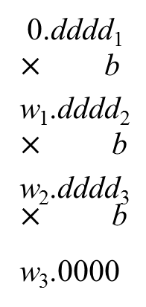
Conversions Base 10 to ANY Base
0
b Q3
b Q2
b Q1
0.dddd₁
$×$ b
w₁.dddd₂
$×$ b
w₂.dddd₃
$×$ b
w₃.0000
R₄
R₃
R₂
R₁
_{W1}
_{w2}
_{w3}
b Decimal
(Decimal)₁₀
(R₁R₂R₃R₄)_{b}
(0.dddd)₁₀
(0.w₁w₂w₃)_{b}
(Decimal.dddd)₁₀
(R₁R₂R₃R₄.w₁w₂w₃)_{b}
Notes:
Quotient until 0, finish
W1, number before the decimal point, until the number after the decimal point reaches to 0

Slide 23
Example 3
• (73)10 = (?)2
73 / 2 = 36 R1(1)
36 / 2 = 18 R2(0)
18 / 2 = 9 R3(0)
9 / 2 = 4 R4(1)
4 / 2 = 2 R5(0)
2 / 2 = 1 R6(0)
1 / 2 = 0 R7(1)
(73)10 = (R7R6R5R4R3R2R1)2
(73)10 = (1001001)2

Slide 24
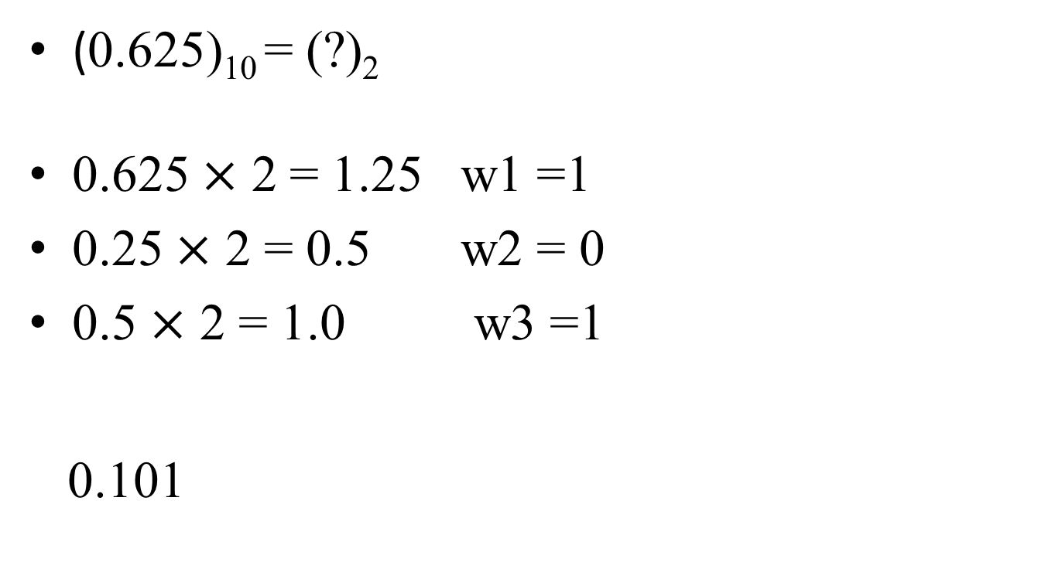
Example 3 – Cont’d
(0.625)₁₀ = (?)₂
0.625 $×$ 2 = 1.25 w1 =1
0.25 $×$ 2 = 0.5 w2 = 0
0.5 $×$ 2 = 1.0 w3 =1
0.101

Slide 25
Example 4
• (345)10 = (?)16
345 / 16 = 21 R1(9)
21 / 16 = 1 R2(5)
1 / 16 = 0 R3(1)
(345)10 = (R3R2R1)16
(345)10 = (159)16

Slide 26
Conversions among Base 2, 8, 16
• 8 = 2³
• 16 = 2⁴
• This enables grouping of binary numbers in 3 and 4 for Base 8 and Base 16 conversion, respectively.

Slide 27
Conversions among Base 2, 8, 16
A single digit in base 2^{p} expands to its equivalent p bits in binary.
This lets us convert directly between binary, hex, and octal.

Slide 28
Example 6
Base 2 to 16:
(1 0 1 0 1 0 1 1 0 0 0 1 0 1 0 0 1 . 0 0 1 1 0)2
0001 0101 0110 0010 1001.00110
1 5 6 2 9 . 3
(15629.3)16

Slide 29
Example 7
Base 8 to 2:
(123.4)8
001 010 011 . 100
(001010011.100)2

Slide 30
Example 8
Base 16 to 2:
(1F.3 )16
0001 1111 . 0011
00011111.0011

Slide 31
Example 9
• (3B)16 = (?)2
• (3B)16 = (00111011)2

Slide 32
Example 10
• (101101)2 = (?)16
• (101101)2 = (2D)16

Slide 33
In-Class Exercise
(553.76)₈ = (? ) ₂
(553.76)₈ = (? )₁₆
(C6B.2)₁₆ = (? )₂

Slide 34
Binary addition
Addition works exactly the same way as in decimal
c2
c1
a1 a0
b1 b0
----------
s2 s1 s0
Example:
1
1 1 1 1
1 0 1 1 0 1
+ 1 0 0 1 1 1
-------------
1 0 1 0 1 0 0
check:
101101 = 2⁵+2³+2²+2⁰ = 32+8+4+1 = 4510
100111 = 2⁵+2²+2¹+2⁰ = 32+4+2+1 = 3910
-------
1010100 = 2⁶+2⁴+2² = 64+16+4 = 8410

Slide 35
Binary subtraction
Subtraction also works the same way as in decimal
10
0
0
10
1 0 1 1 0 1
- 1 0 0 1 1 1
------------------
0 0 0 1 1 0
check:
101101 = 4510
100111 = 3910
--------- ---
110 = 610

Slide 36


Binary multiplication
Same method, only ever multiply by “1” to get the interim results
Starting at the right end of the multiplier (bottom number), examine each bit.
If 0, skip
If 1, copy the multiplicand right-aligned under the multiplier bit you are examining
After all multiplier bits examined, add the interim results
1 0 1 1
x 1 0 1
copy
-------
copy
1 0 1 1
1 0 1 1
-----------
1 1 0 1 1 1

Slide 37
Binary division
Just like decimal division
0
1 1 1
1 1 1
1 1
- 0 0
1 1
0
0
0
1 0 1
1
-
1
1
1
1
-
1
1
1
-
0
1
0
1
1
0
1
1 1
1 1
0 0 (remainder)

Slide 38
Other Notational Systems

Slide 39
Signed Magnitude
Notation: “Nsm”
The first bit shows the sign of N, “0” for positive, “1” for negative.
The rest of the bits are |N|.
Example:
+(1101)2 = (0 1101)sm
- (1101)2 = (1 1101)sm

Slide 40
1’s Complement
Notation: N1s
The first bit shows the sign of N, as in Signed Magnitude.
If the number is positive, the rest of the bits are |N|.
If the number is negative, the rest of the bits are (2^{n} - 1) - |N| where n is the # of bits in |N|.
Example:
+(1101)2 = (0 1101)1s
- (1101)2
we determine (2⁴ – 1) - 1101 = 1111 - 1101 = 0010
then - (1101)2 = (1 0010)1s
Note that we can obtain (2^{n} - 1) - |N| by replacing every “1” in |N| with “0” and every “0” with “1”.
This is called taking the bit-by-bit complement of |N|.
General concept: The complement of 0 is 1, the complement of 1 is 0.

Slide 41
2’s Complement
Notation: N2s
The first bit shows the sign of N, as in Signed Magnitude.
If the number is positive, the rest of the bits are |N|.
If the number is negative, the rest of the bits are (2^{n} - 1) - |N| +1 where n is the # bits in |N|.
Examples:
+(1101)₂ = (0 1101)_{2s}
-(1101)2
→ 1111 - 1101 + 1 = 0011 →
- (1101)₂ = (1 0011)_{2s}
Shortcuts to determine (2^{n}-1) - |N| +1:
Take the bit-by-bit complement of |N| and add 1

Slide 42
Why complement number systems?
If numbers are represented in 1’s or 2’s complement number systems, numbers of either sign will add correctly.

Slide 43
Subtraction with Complements
The subtraction using complement is more efficient than implementing subtraction using digital hardware.

Slide 44
Other Binary Codes

Slide 45
Binary Codes
Code consisting of 1 and 0, high and low, on and off, … two distinct states.
Represent not only numbers but also information
Create unique symbols for a set of elements
For n-bits, 2^{n} distinct items or states can be represented by the code

Slide 46
Binary Codes
BCD – Binary Coded Decimal
Gray
ASCII - American Standard Code for Information Interchange

Slide 47
BCD (Binary Coded Decimal) Code
Code to represent decimal numbers, not binary numbers, although they are coded with binary bits.
Binary Value Decimal Digit
Binary Value Decimal Digit
0000
0001
0010
0011
0100
0101
0110
0111
0
1
2
3
4
5
6
7
1000
1001
1010
1011
1100
1101
1110
1111
8
9
Not Used
Not Used
Not Used
Not Used
Not Used
Not Used
(25)10 = (0010 0101)BCD
(345.6)10 =
(0001 0011)BCD =
(0011 0100 0101 . 0110)BCD
(13)10

Slide 48

BCD Addition
To add 2 multiple-digit BCD numbers, first add them as if they were normal binary numbers.
Then check each group of 4 bits. If the group is 9 (1001)or less, it is OK.
When a group of 4 bits is 10 or more, add 6, adding any carry into the next group of 4 bits.
Decimal
BCD
184
+ 576
760
0001 1000 0100
0101 0111 0110
0110 1111 1010
0110 0110
0111 0110 0000
These two groups of 4 bits are >9,
so we have to adjust by adding 6 to
each of them.

Slide 49
Excess-3 code
Another way of representing decimal numbers.
Each digit of the decimal number is represented by 4 bits, equal to the BCD code plus 3.
Digit
0
1
2
3
4
5
6
7
8
9
Excess-3 code
0011
0100
0101
0110
0111
1000
1001
1010
1011
1100
Example:
13410 = (0100 0110 0111)Excess-3

Slide 50
Gray Code
Useful for representing continuous data stream, ran through AD converter
Key--requires only one bit change between adjacent values
Decimal
0
1
2
3
4
5
6
7
Gray Code
0000
0001
0011
0010
0110
0111
0101
0100
Decimal
8
9
10
11
12
13
14
15
Gray Code
1100
1101
1111
1110
1010
1011
1001
1000

Slide 51
ASCII Code
American Standard Code for Information Interchange or ASCII. ASCII assigns a unique binary representation for specific characters and symbols
7-bit code 128 unique symbols
Typically stored in computer as byte, 8 bit
Additional bit can be:
set to zero
used to represent additional 128 symbols (Extended ASCII Table)
used in parity error checking

Slide 52
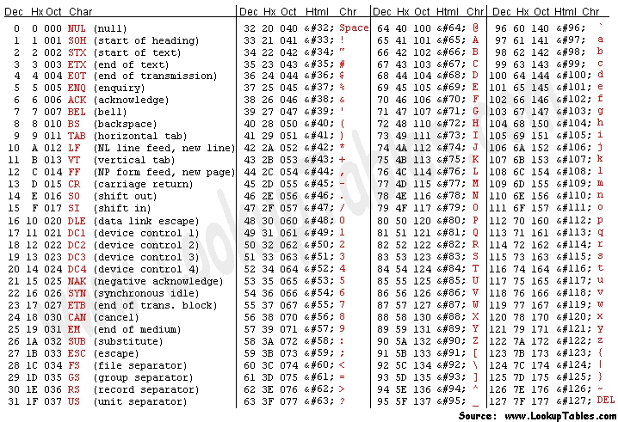
ASCII Table

Slide 53
ASCII Examples
•What is the ASCII code for “EE229” in decimal?
069, 069, 050, 050, 057
•What is the ASCII code for “EE229” in 8-bit binary?
0100 0101, 0100 0101, 0011 0010, 00110010, 0011 1001

Slide 54
Binary Logic

Slide 55

The Basic Logic Operations
x y
xy
This is a “Truth
0
0
1
1
0
1
0
1
0
0
0
1
Table” (The
operation’s
result for every
combination
AND
.
x y or xy
of values)
x y
x+y
0
0
0
OR
x+y
0
1
1
1
0
1
1
1
1
x
x’
NOT or
COMPLEMENT or
x’($\overline{x})$
0
1
1
0

Slide 56
Truth Tables
The relationship between binary inputs and outputs for a given operation can be summarized in a truth table.
A truth table list all possible input combinations and the resulting output.
For n input variables there are 2^{n} input combinations.

Slide 57
Using Logic Expressions
We can write logical and arithmetic expressions by combining logic values, variables, and operations
Example:
“If it’s Winter, the grass is brown. If it’s Summer and it’s a drought, the grass is brown. Else, the grass is green.”
Define variables:
S=0 if it’s Winter, S=1 if it’s Summer
D=1 if there’s a drought, D=0 if there’s no drought.
B=1 if the grass is brown, B=0 if the grass is green
S
0
0
1
1
D
0
1
0
1
B
1
1
0
1
Logic Expression:
B = S’D’ + S’D + SD

Slide 58
Using Logic Expressions (2)
Example (arithmetic):
Truth Table:
a
b
c
s
0
0
1
1
0
1
0
1
0
0
0
1
0
1
1
0
The University Of Alabama in Huntsville
a
+ b
c s
Logic Expressions:
c = ab
s = a’b + ab’

Slide 59
Digital Logic Circuits
Implementation of Logic variables and operations in electronics
– Values (0 and 1) represented by voltage levels
– Variables implemented by electrical connections
– Operations implemented by logic gates
Basic Logic Gate Symbols
x
y
x
y
xy
x+y
wxyz
AND
OR
NOT
w
x
y
z

Slide 60



Truth Tables
NOT
AND
OR
A
F = A’
A B
F = AB
A B
F = A+B
0
1
1
0
0
0
0
1
0
0
0
0
0
1
0
1
1 0
0
1 0
1
1
1
1
1
1
1

Slide 61
Timing Diagram
x
y
Output g
Used to represents the output of a gate or system of gates for all possible combination of inputs.
What is the logic equation which defines g based on inputs x & y?
g=x+y

Slide 62
Conclusion
Be able to count in binary, octal, and hex.
Be able to convert any base to base 2.
Be able to convert a base 10 number to any base.
Know the Signed-Magnitude and Signed-Complement number
representations.
Be able to add and subtract base 2 numbers
Unsigned
Signed-2’s complement form
Difference between Binary code and number
Understand ASCII representation
NOT, AND, OR
Gates
Truth table
Timing diagram

